Slide 1
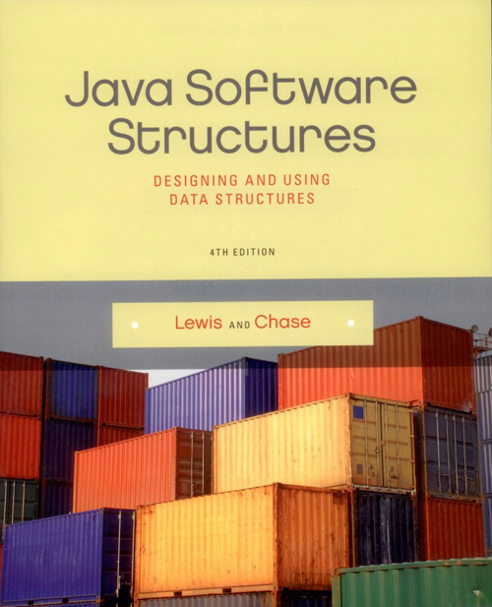
Chapter 4
Linked Structures - Stacks

Slide 2
Chapter Scope
Object references as links
Linked vs. array-based structures
Managing linked lists
Linked implementation of a stack

Slide 3

Linked Structures
An alternative to array-based implementations are linked structures
A linked structure uses object references to create links between objects
Recall that an object reference variable holds the address of an object

Slide 4
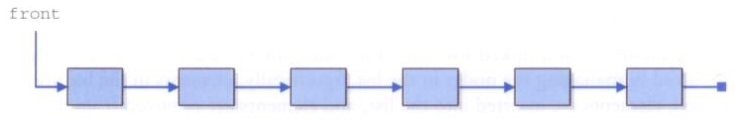
Linked Structures
A Person object, for instance, could contain a reference to another Person object
A series of Person objects would make up a linked list:

Slide 5
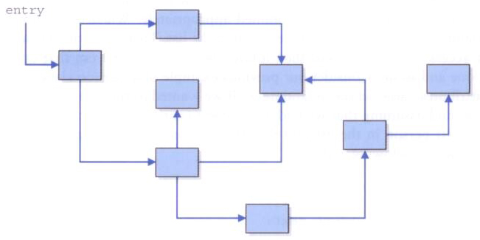
Linked Structures
Links could also be used to form more complicated, non-linear structures

Slide 6
Linked Lists
There are no index values built into linked lists
To access each node in the list you must follow the references from one node to the next
Person current = first;
while (current != null)
{
System.out.println(current);
current = current.next;
}

Slide 7
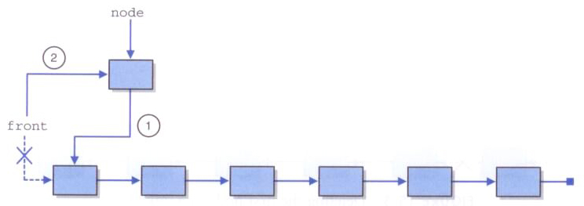
Linked Lists
Care must be taken to maintain the integrity of the links
To insert a node at the front of the list, first point the new node to the front node, then reassign the front reference

Slide 8
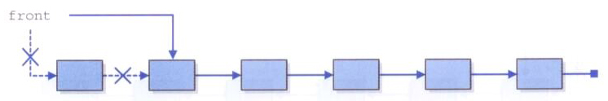
Linked Lists
To delete the first node, reassign the front reference accordingly
If the deleted node is needed elsewhere, a reference to it must be established before reassigning the front pointer

Slide 9
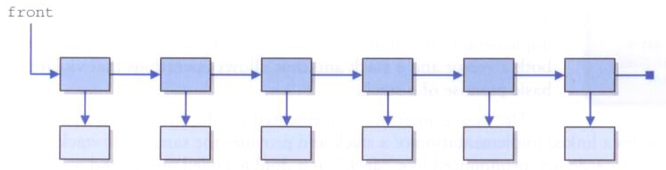
Linked Lists
So far we've assumed that the list contains nodes that are self-referential (Person points to a Person)
But often we'll want to make lists of objects that don't contain such references
Solution: have a separate Node class that forms the list and holds a reference to the objects being stored

Slide 10
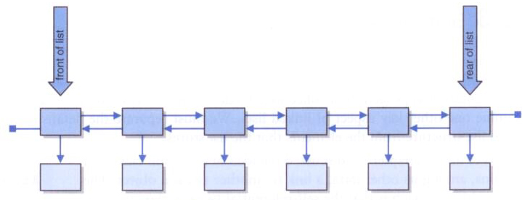
Linked Lists
There are many variations on the basic linked list concept
For example, we could create a doubly-linked list with next and previous references in each node and a separate pointer to the rear of the list

Slide 11
Stacks Revisited
In the previous chapter we developed our own array-based version of a stack, and we also used the java.util.Stack class from the Java API
The API's stack class is derived from Vector, which has many non-stack abilities
It is, therefore, not the best example of inheritance, because a stack is not a vector
It's up to the user to use a Stack object only as intended

Slide 12
Stacks Revisited
Stack characteristics can also be found by using the Deque interface from the API
The LinkedList class implements the Deque interface
Deque stands for double-ended queue, and will be explored further later
For now, we will use the stack characteristics of a Deque to solve the problem of traversing a maze

Slide 13
Traversing a Maze
Suppose a two-dimensional maze is represented as a grid of 1 (path) and 0 (wall)
Goal: traverse from the upper left corner to the bottom right (no diagonal moves)
9 13
1 1 1 0 1 1 0 0 0 1 1 1 1
1 0 0 1 1 0 1 1 1 1 0 0 1
1 1 1 1 1 0 1 0 1 0 1 0 0
0 0 0 0 1 1 1 0 1 0 1 1 1
1 1 1 0 1 1 1 0 1 0 1 1 1
1 0 1 0 0 0 0 1 1 1 0 0 1
1 0 1 1 1 1 1 1 0 1 1 1 1
1 0 0 0 0 0 0 0 0 0 0 0 0
1 1 1 1 1 1 1 1 1 1 1 1 1

Slide 14
Traversing a Maze
Using a stack, we can perform a backtracking algorithm to find a solution to the maze
An object representing a position in the maze is pushed onto the stack when trying a path
If a dead end is encountered, the position is popped and another path is tried
We'll change the integers in the maze grid to represent tried-but-failed paths (2) and the successful path (3)

Slide 15
import java.util.*;
import java.io.*;
/**
* Maze represents a maze of characters. The goal is to get from the
* top left corner to the bottom right, following a path of 1's. Arbitrary
* constants are used to represent locations in the maze that have been TRIED
* and that are part of the solution PATH.
*
* @author Lewis and Chase
* @version 4.0
*/
public class Maze
{
private static final int TRIED = 2;
private static final int PATH = 3;
private int numberRows, numberColumns;
private int[][] grid;

Slide 16
/**
* Constructor for the Maze class. Loads a maze from the given file.
* Throws a FileNotFoundException if the given file is not found.
*
* @param filename the name of the file to load
* @throws FileNotFoundException if the given file is not found
*/
public Maze(String filename) throws FileNotFoundException
{
Scanner scan = new Scanner(new File(filename));
numberRows = scan.nextInt();
numberColumns = scan.nextInt();
grid = new int[numberRows][numberColumns];
for (int i = 0; i < numberRows; i++)
for (int j = 0; j < numberColumns; j++)
grid[i][j] = scan.nextInt();
}

Slide 17
/**
* Marks the specified position in the maze as TRIED
*
* @param row the index of the row to try
* @param col the index of the column to try
*/
public void tryPosition(int row, int col)
{
grid[row][col] = TRIED;
}
/**
* Return the number of rows in this maze
*
* @return the number of rows in this maze
*/
public int getRows()
{
return grid.length;
}
/**
* Return the number of columns in this maze
*
* @return the number of columns in this maze
*/
public int getColumns()
{
return grid[0].length;
}

Slide 18
/**
* Marks a given position in the maze as part of the PATH
*
* @param row the index of the row to mark as part of the PATH
* @param col the index of the column to mark as part of the PATH
*/
public void markPath(int row, int col)
{
grid[row][col] = PATH;
}
/**
* Determines if a specific location is valid. A valid location
* is one that is on the grid, is not blocked, and has not been TRIED.
*
* @param row the row to be checked
* @param column the column to be checked
* @return true if the location is valid
*/
public boolean validPosition(int row, int column)
{
boolean result = false;
// check if cell is in the bounds of the matrix
if (row >= 0 && row < grid.length &&
column >= 0 && column < grid[row].length)
// check if cell is not blocked and not previously tried
if (grid[row][column] == 1)
result = true;
return result;
}

Slide 19
/**
* Returns the maze as a string.
*
* @return a string representation of the maze
*/
public String toString()
{
String result = "\n";
for (int row=0; row < grid.length; row++)
{
for (int column=0; column < grid[row].length; column++)
result += grid[row][column] + "";
result += "\n";
}
return result;
}
}

Slide 20
import java.util.*;
/**
* MazeSolver attempts to traverse a Maze using a stack. The goal is to get from the
* given starting position to the bottom right, following a path of 1's. Arbitrary
* constants are used to represent locations in the maze that have been TRIED
* and that are part of the solution PATH.
*
* @author Lewis and Chase
* @version 4.0
*/
public class MazeSolver
{
private Maze maze;
/**
* Constructor for the MazeSolver class.
*/
public MazeSolver(Maze maze)
{
this.maze = maze;
}

Slide 21
/**
* Attempts to traverse the maze using a stack. Inserts special
* characters indicating locations that have been TRIED and that
* eventually become part of the solution PATH.
*
* @param row row index of current location
* @param column column index of current location
* @return true if the maze has been solved
*/
public boolean traverse()
{
boolean done = false;
int row, column;
Position pos = new Position();
Deque<Position> stack = new LinkedList<Position>();
stack.push(pos);
while (!(done) && !stack.isEmpty())
{
pos = stack.pop();
maze.tryPosition(pos.getx(),pos.gety()); // this cell has been tried
if (pos.getx() == maze.getRows()-1 && pos.gety() == maze.getColumns()-1)
done = true; // the maze is solved
else
{
push_new_pos(pos.getx() - 1,pos.gety(), stack);
push_new_pos(pos.getx() + 1,pos.gety(), stack);
push_new_pos(pos.getx(),pos.gety() - 1, stack);
push_new_pos(pos.getx(),pos.gety() + 1, stack);
}
}
return done;
}

Slide 22
/**
* Push a new attempted move onto the stack
* @param x represents x coordinate
* @param y represents y coordinate
* @param stack the working stack of moves within the grid
* @return stack of moves within the grid
*/
private void push_new_pos(int x, int y,
Deque<Position> stack)
{
Position npos = new Position();
npos.setx(x);
npos.sety(y);
if (maze.validPosition(x,y))
stack.push(npos);
}
}

Slide 23
import java.util.*;
import java.io.*;
/**
* MazeTester determines if a maze can be traversed.
*
* @author Lewis and Chase
* @version 4.0
*/
public class MazeTester
{
/**
* Creates a new maze, prints its original form, attempts to
* solve it, and prints out its final form.
*/
public static void main(String[] args) throws FileNotFoundException
{
Scanner scan = new Scanner(System.in);
System.out.print("Enter the name of the file containing the maze: ");
String filename = scan.nextLine();
Maze labyrinth = new Maze(filename);
System.out.println(labyrinth);
MazeSolver solver = new MazeSolver(labyrinth);
if (solver.traverse())
System.out.println("The maze was successfully traversed!");
else
System.out.println("There is no possible path.");
System.out.println(labyrinth);
}
}

Slide 24
Implementing a Stack using Links
Let's now implement our own version of a stack that uses a linked list to hold the elements
Our LinkedStack<T> class stores a generic type T and implements the same StackADT<T> interface used previously
A separate LinearNode<T> class forms the list and hold a reference to the element stored
An integer count will store how many elements are currently in the stack

Slide 25
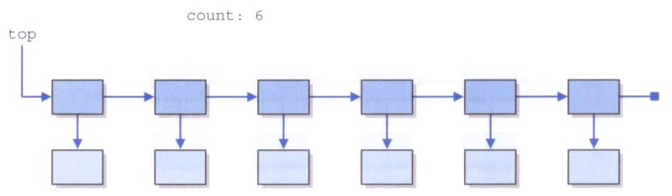
Implementing a Stack using Links
Since all activity on a stack happens on one end, a single reference to the front of the list will represent the top of the stack

Slide 26
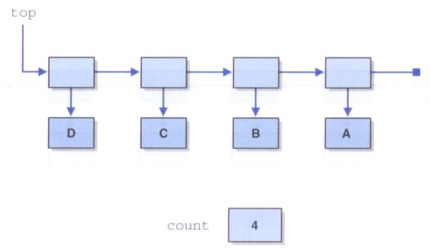
Implementing a Stack using Links
The stack after A, B, C, and D are pushed, in that order:

Slide 27
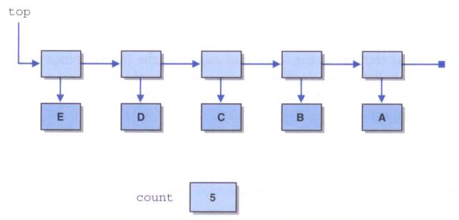
Implementing a Stack using Links
After E is pushed onto the stack:

Slide 28
package jsjf;
/**
* Represents a node in a linked list.
*
* @author Lewis and Chase
* @version 4.0
*/
public class LinearNode<T>
{
private LinearNode<T> next;
private T element;
/**
* Creates an empty node.
*/
public LinearNode()
{
next = null;
element = null;
}
/**
* Creates a node storing the specified element.
* @param elem element to be stored
*/
public LinearNode(T elem)
{
next = null;
element = elem;
}

Slide 29
/**
* Returns the node that follows this one.
* @return reference to next node
*/
public LinearNode<T> getNext()
{
return next;
}
/**
* Sets the node that follows this one.
* @param node node to follow this one
*/
public void setNext(LinearNode<T> node)
{
next = node;
}
/**
* Returns the element stored in this node.
* @return element stored at the node
*/
public T getElement()
{
return element;
}
/**
* Sets the element stored in this node.
* @param elem element to be stored at this node
*/
public void setElement(T elem)
{
element = elem;
}
}

Slide 30
package jsjf;
import jsjf.exceptions.*;
import java.util.Iterator;
/**
* Represents a linked implementation of a stack.
*
* @author Lewis and Chase
* @version 4.0
*/
public class LinkedStack<T> implements StackADT<T>
{
private int count;
private LinearNode<T> top;
/**
* Creates an empty stack.
*/
public LinkedStack()
{
count = 0;
top = null;
}

Slide 31
/**
* Adds the specified element to the top of this stack.
* @param element element to be pushed on stack
*/
public void push(T element)
{
LinearNode<T> temp = new LinearNode<T>(element);
temp.setNext(top);
top = temp;
count++;
}
/**
* Removes the element at the top of this stack and returns a
* reference to it.
* @return element from top of stack
* @throws EmptyCollectionException if the stack is empty
*/
public T pop() throws EmptyCollectionException
{
if (isEmpty())
throw new EmptyCollectionException("stack");
T result = top.getElement();
top = top.getNext();
count--;
return result;
}

Slide 32
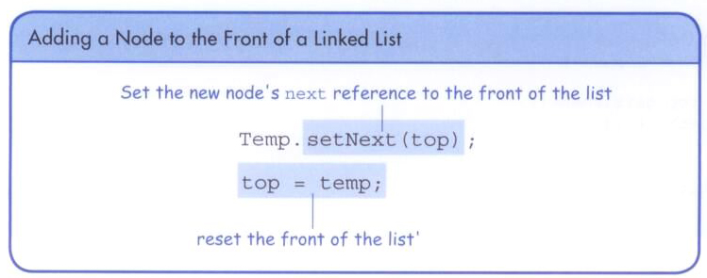
Implementing a Stack using Links

